Slide 1
2023 North Pacific SWO assessment
ISC BILLWG
Slides updated as work progresses

Slide 2
Modeling Team Meeting I
Jan 17/18, 2023

Slide 3
Status Update
Organization:
Github
Quarto
Goal is to make the assessments transparent, easily replicated/modified in future years, and easy to onboard new BILLWG members
No more emailing SS3 input files ☺
Development Progress
Data in – model version 3.30.20
Model converges/hessian inverts
Population biomass unrealistic (10²³)
Dropped JPN EPO size comp (sample size)
Separated US LL Deep size comp – sex specific length as its own fleet
Still considering aggregating all size comp or dropping fleet entirely

Slide 4
02/21/23 Status Update
Current actively updated model
Progress:
Model converges
Positive definite Hessian
Gradient <0.0001
Fits data reasonably/no parameters on the bounds
Initial equilibrium catch likelihood problem
Dropped JPN CODF size data
IATTC size data double normal selectivity (was asymptotic lognormal)
Removed sex-specific size data
Next steps
3. Add back in sex-specific data
2. Use likelihood profile to explore dropping/down-weighting size comp or CPUE indices
1. Adding a few blocks to improve fit to size comp
Continue trying to solve initial equilibrium catch likelihood
For future model development:
2-area model with tagging data
Explore an environmental index for recruitment?

Slide 5
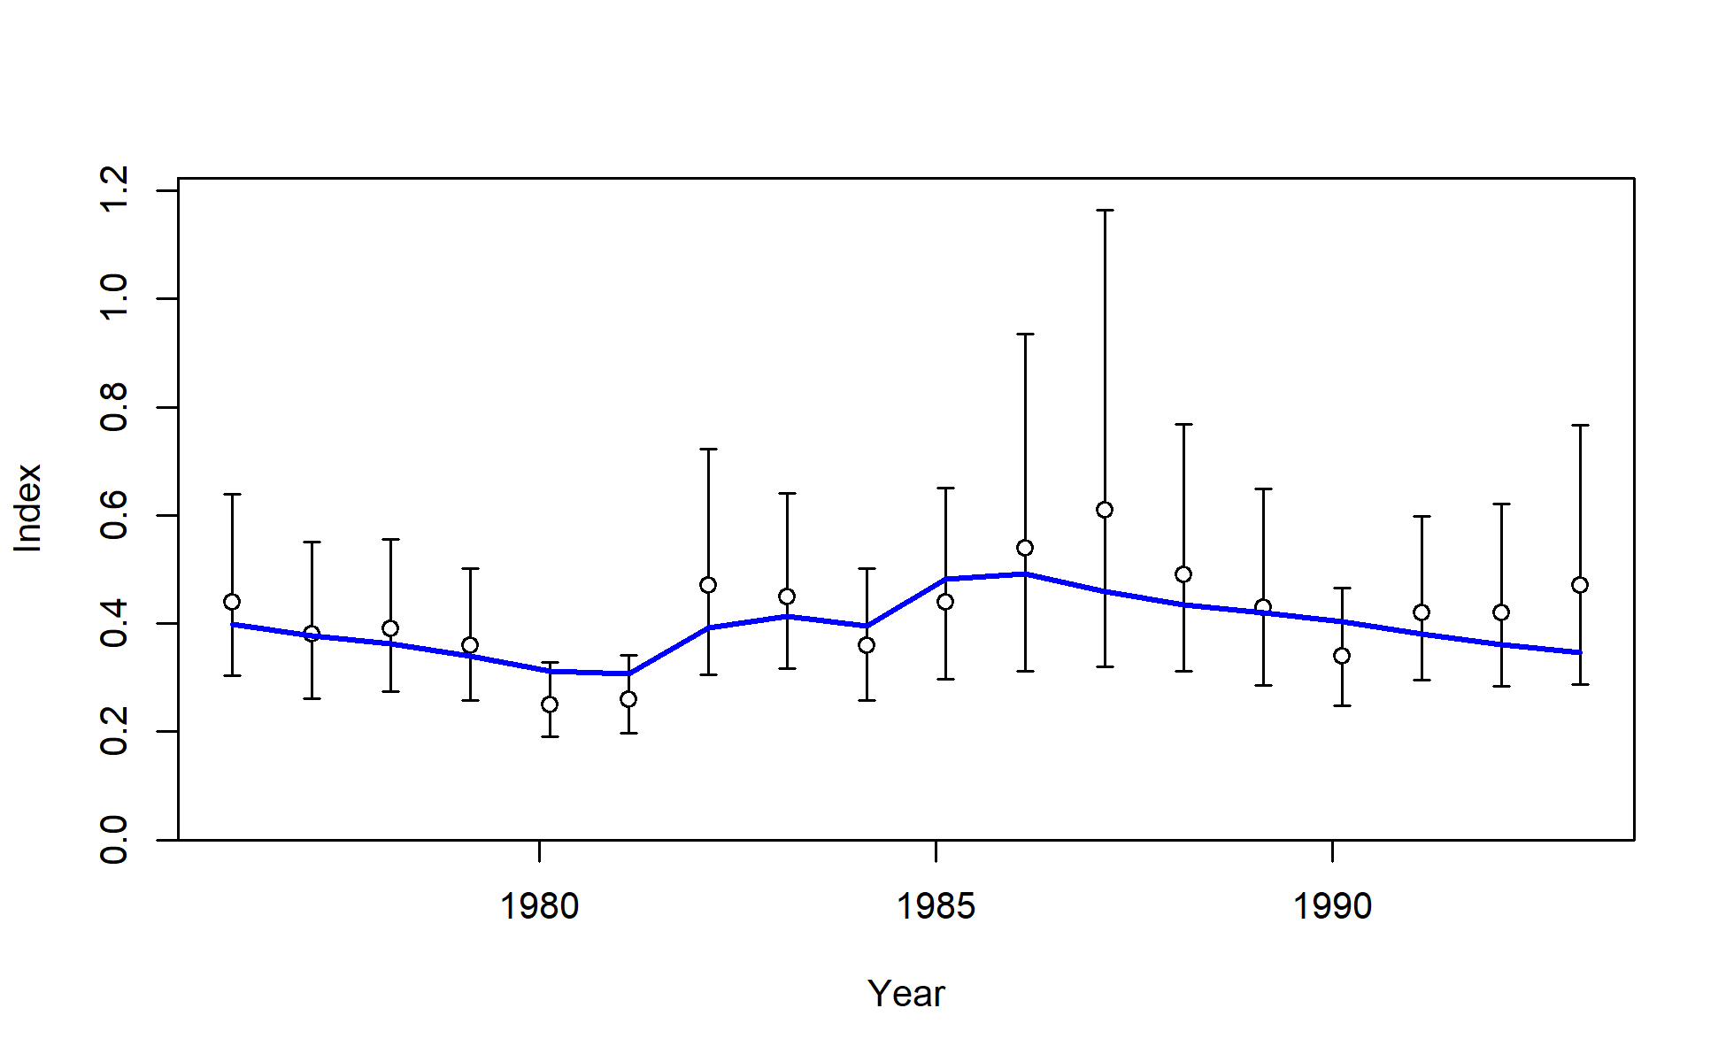
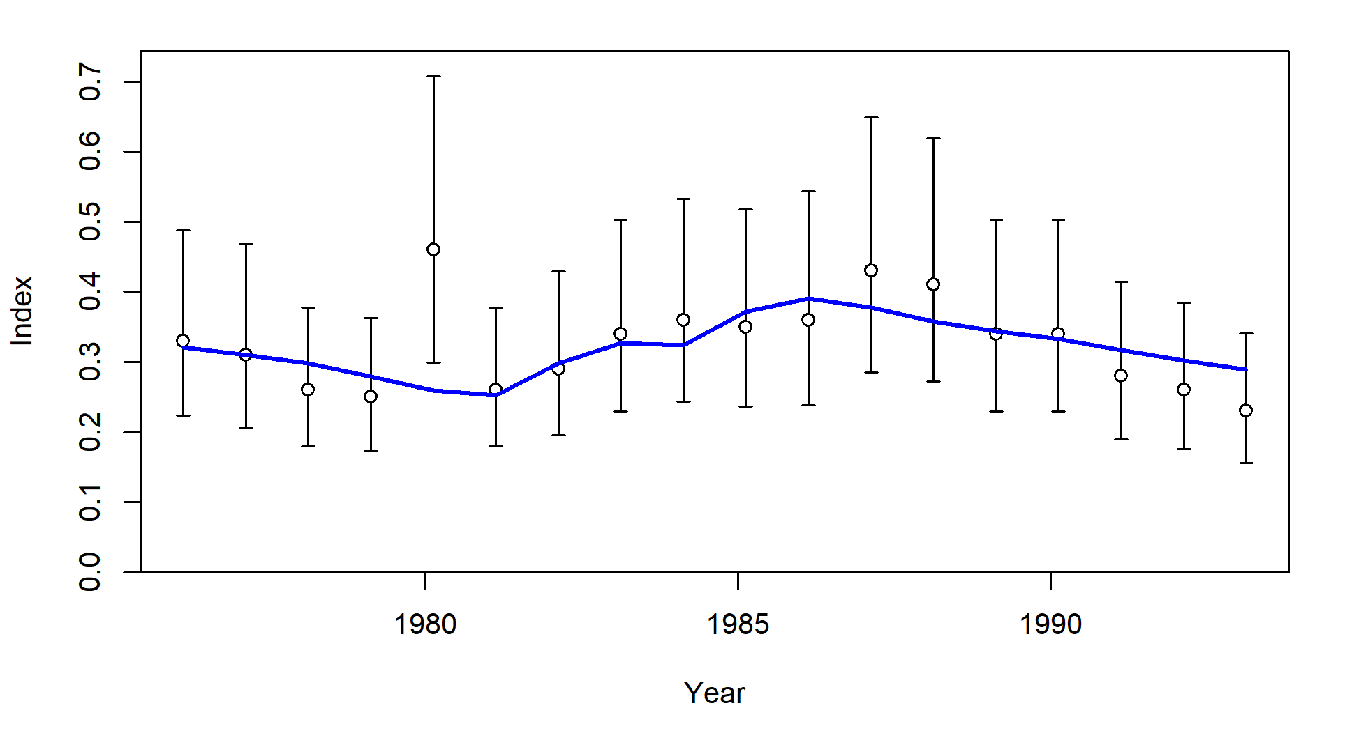
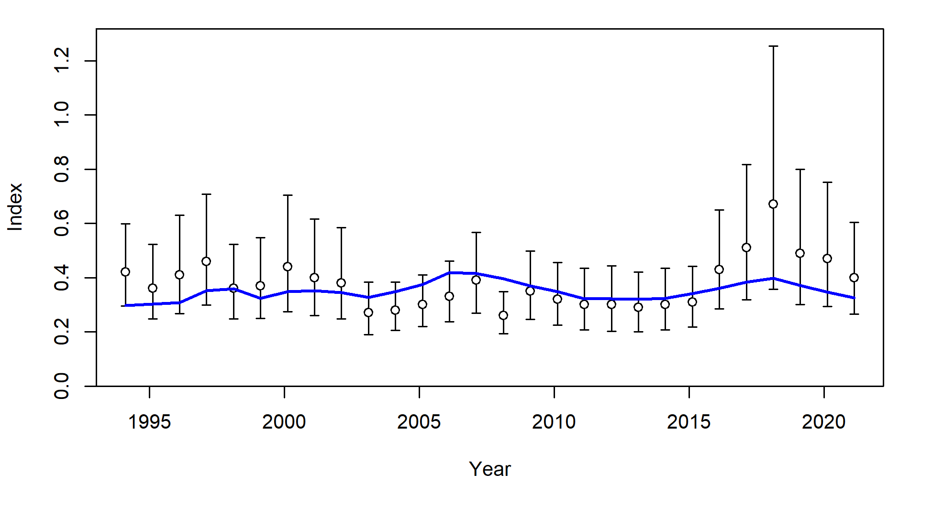
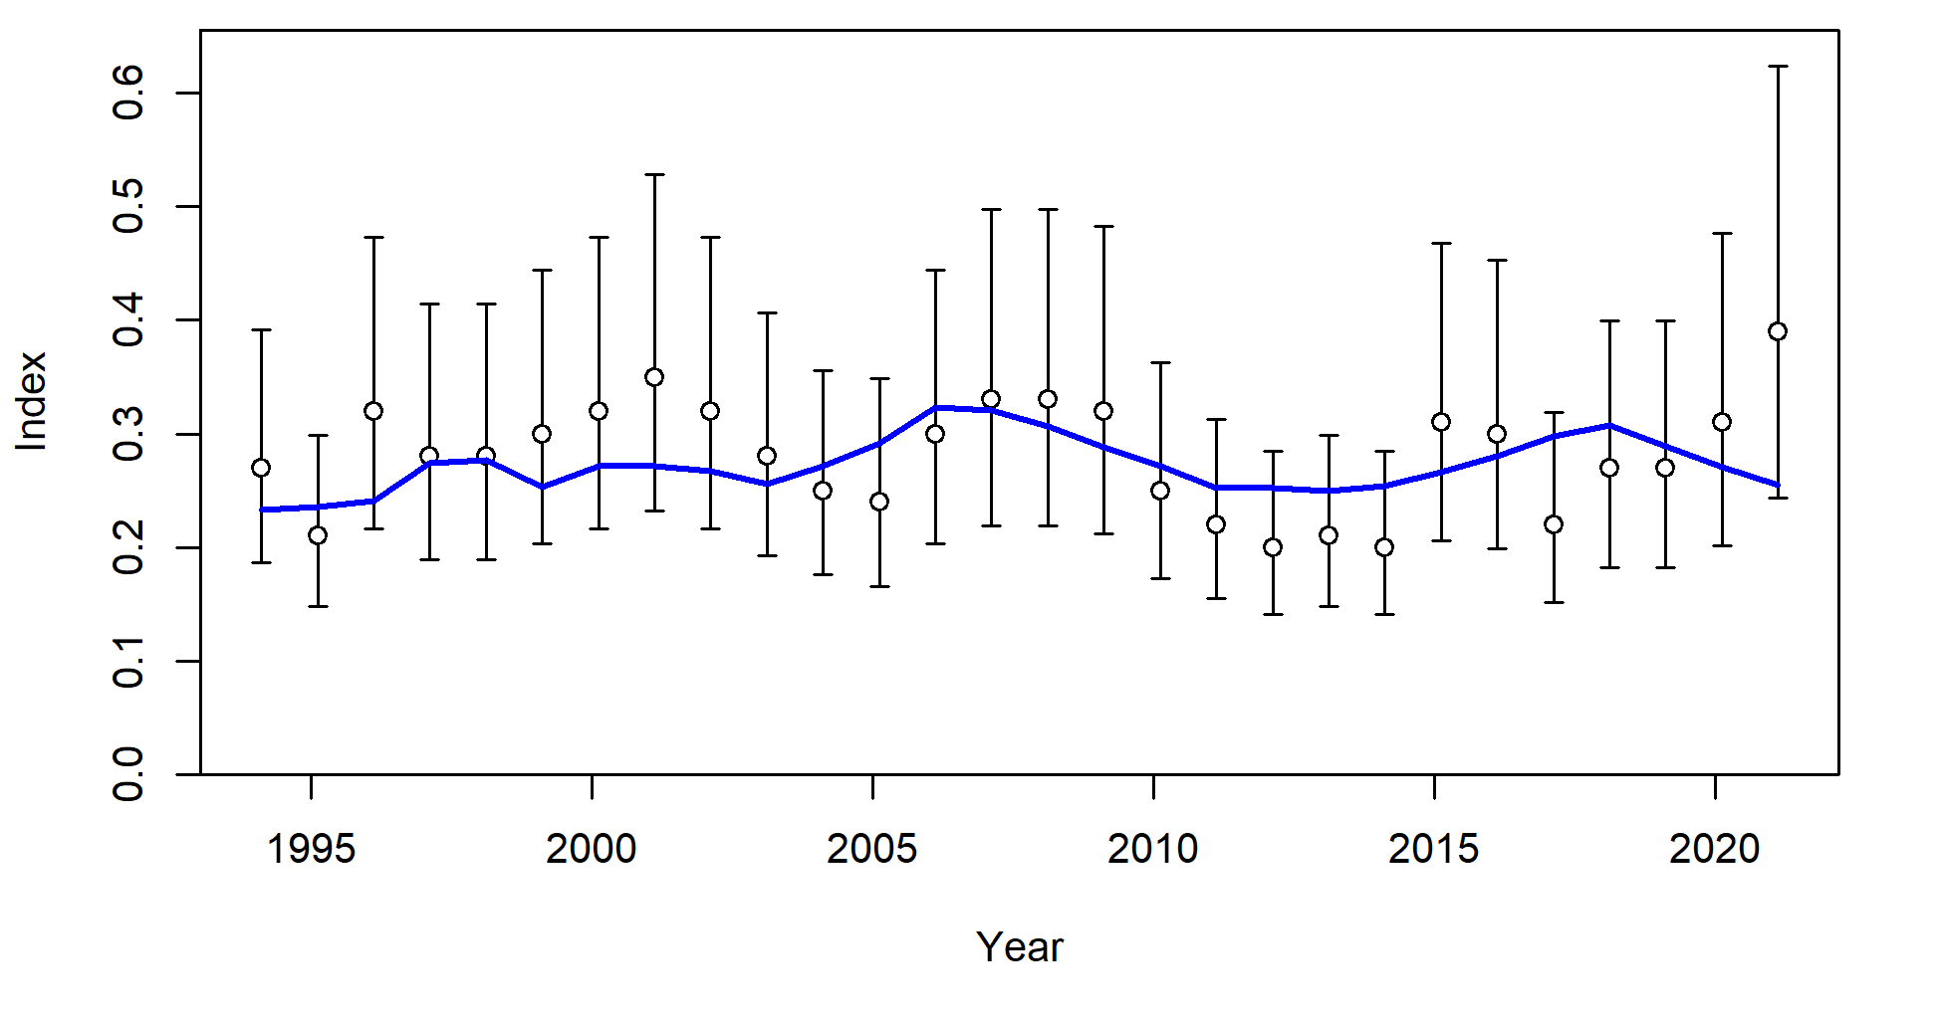
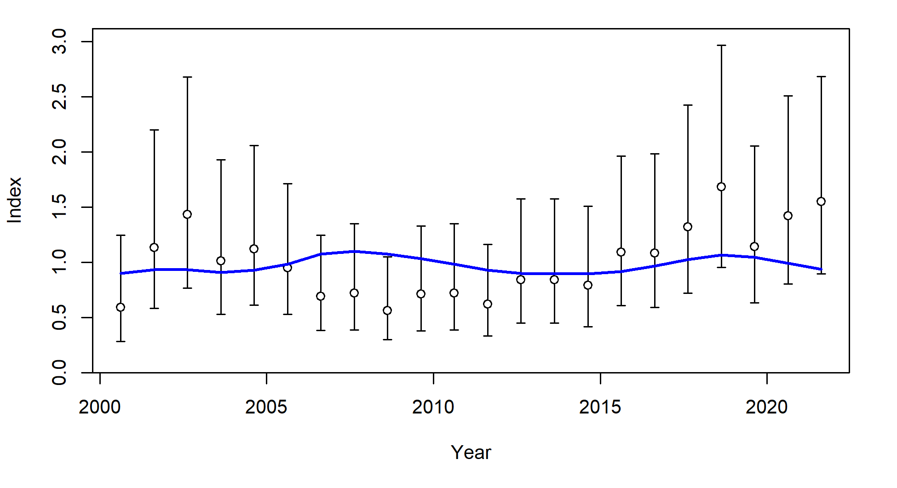
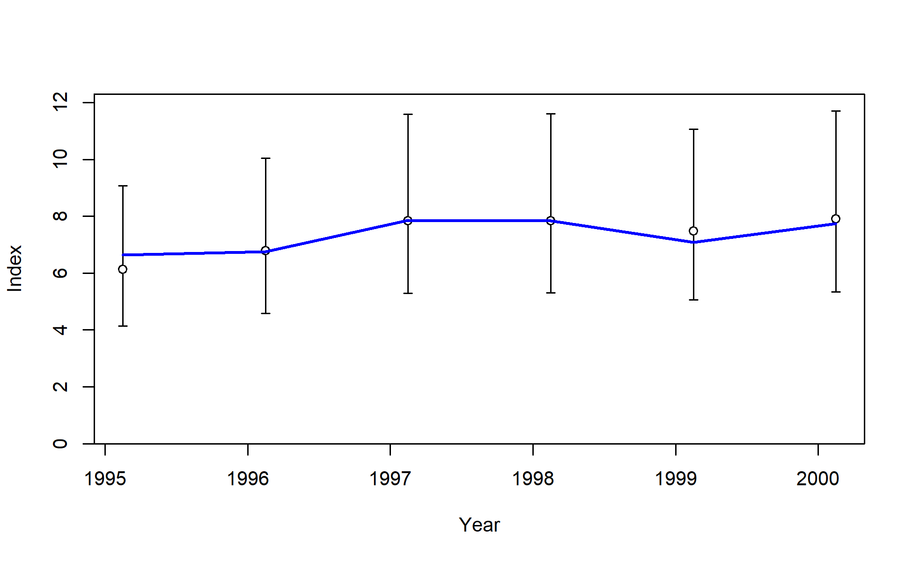
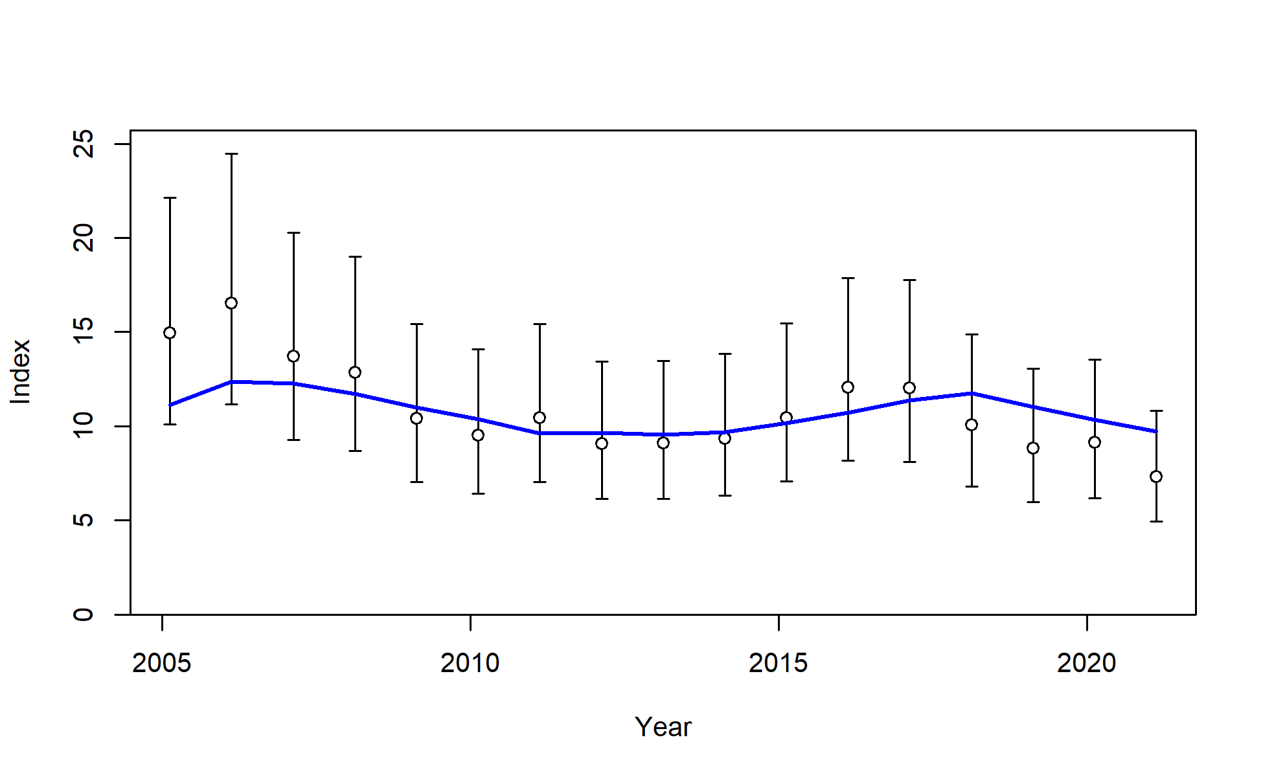
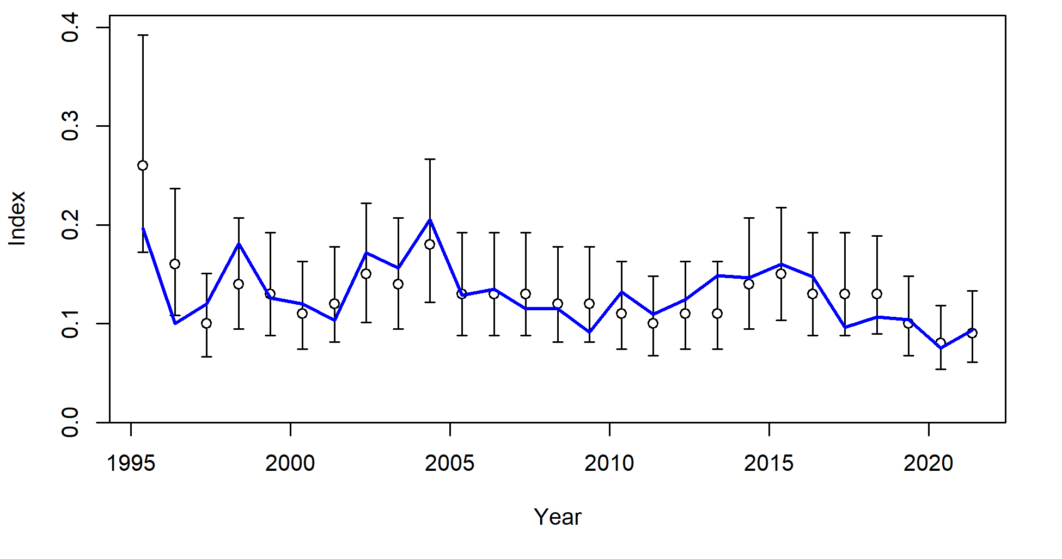
S1_JPN_WCNPO_OSDWLL_early_Area1
S2_JPN_WCNPO_OSDWCOLL_late_Area1
S3_JPN_WCNPO_OSDWLL_early_Area2
S4_JPN_WCNPO_OSDWLL_late_Area2
S5_TWN_WCNPO_DWLL_late
S8_US_WCNPO_LL_shallow_late
S6_US_WCNPO_LL_deep
S7_US_WCNPO_LL_shallow_early

Slide 6
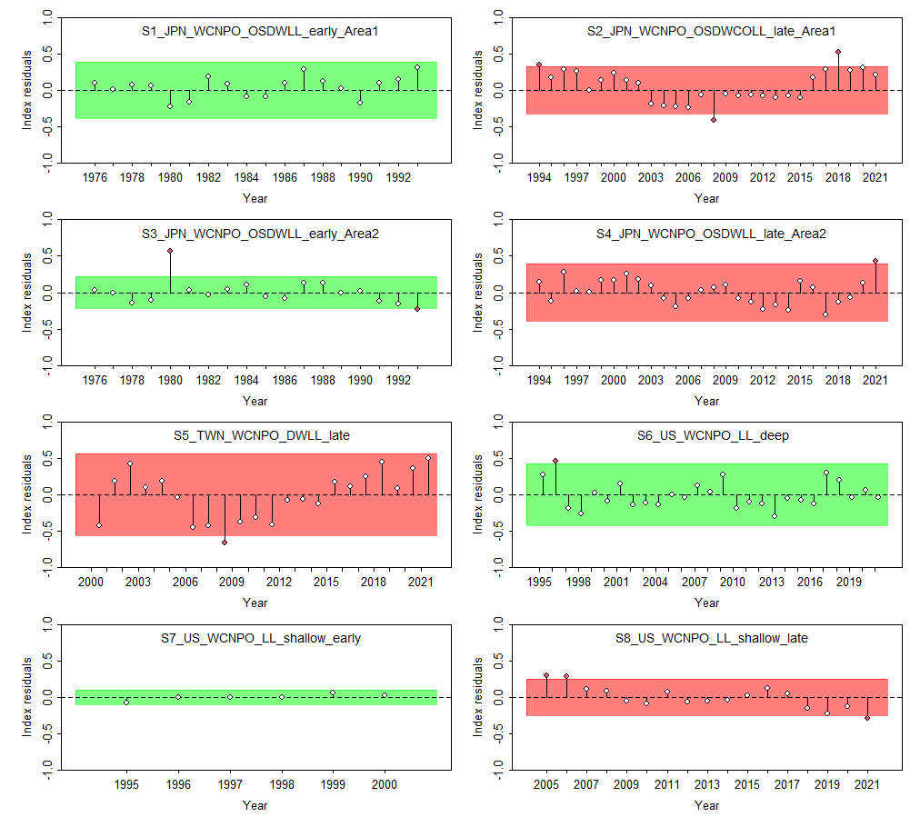

Slide 7
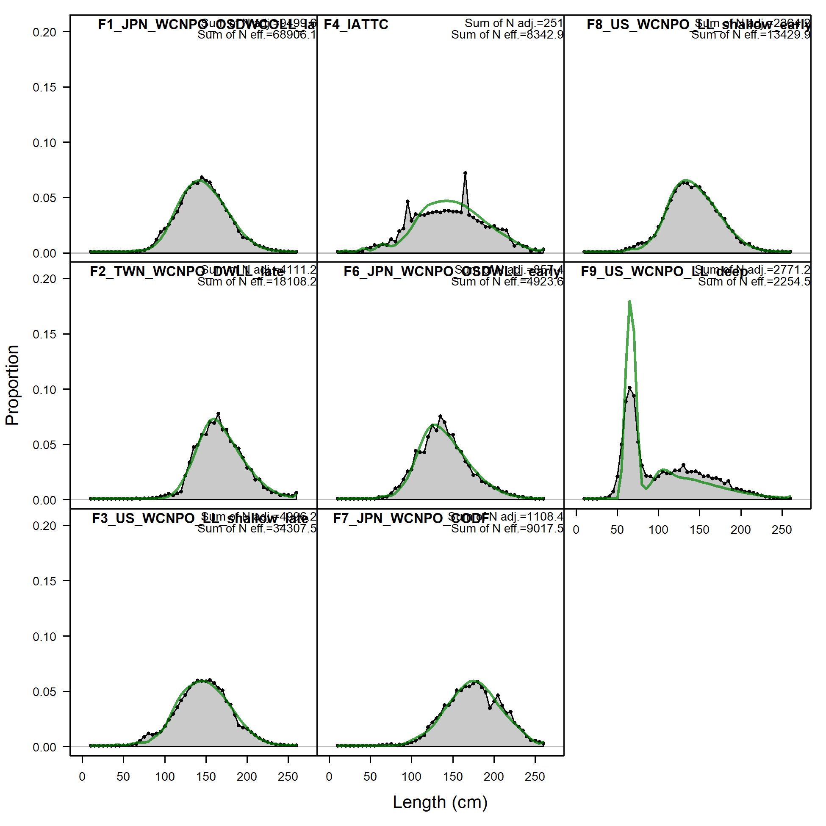

Slide 8
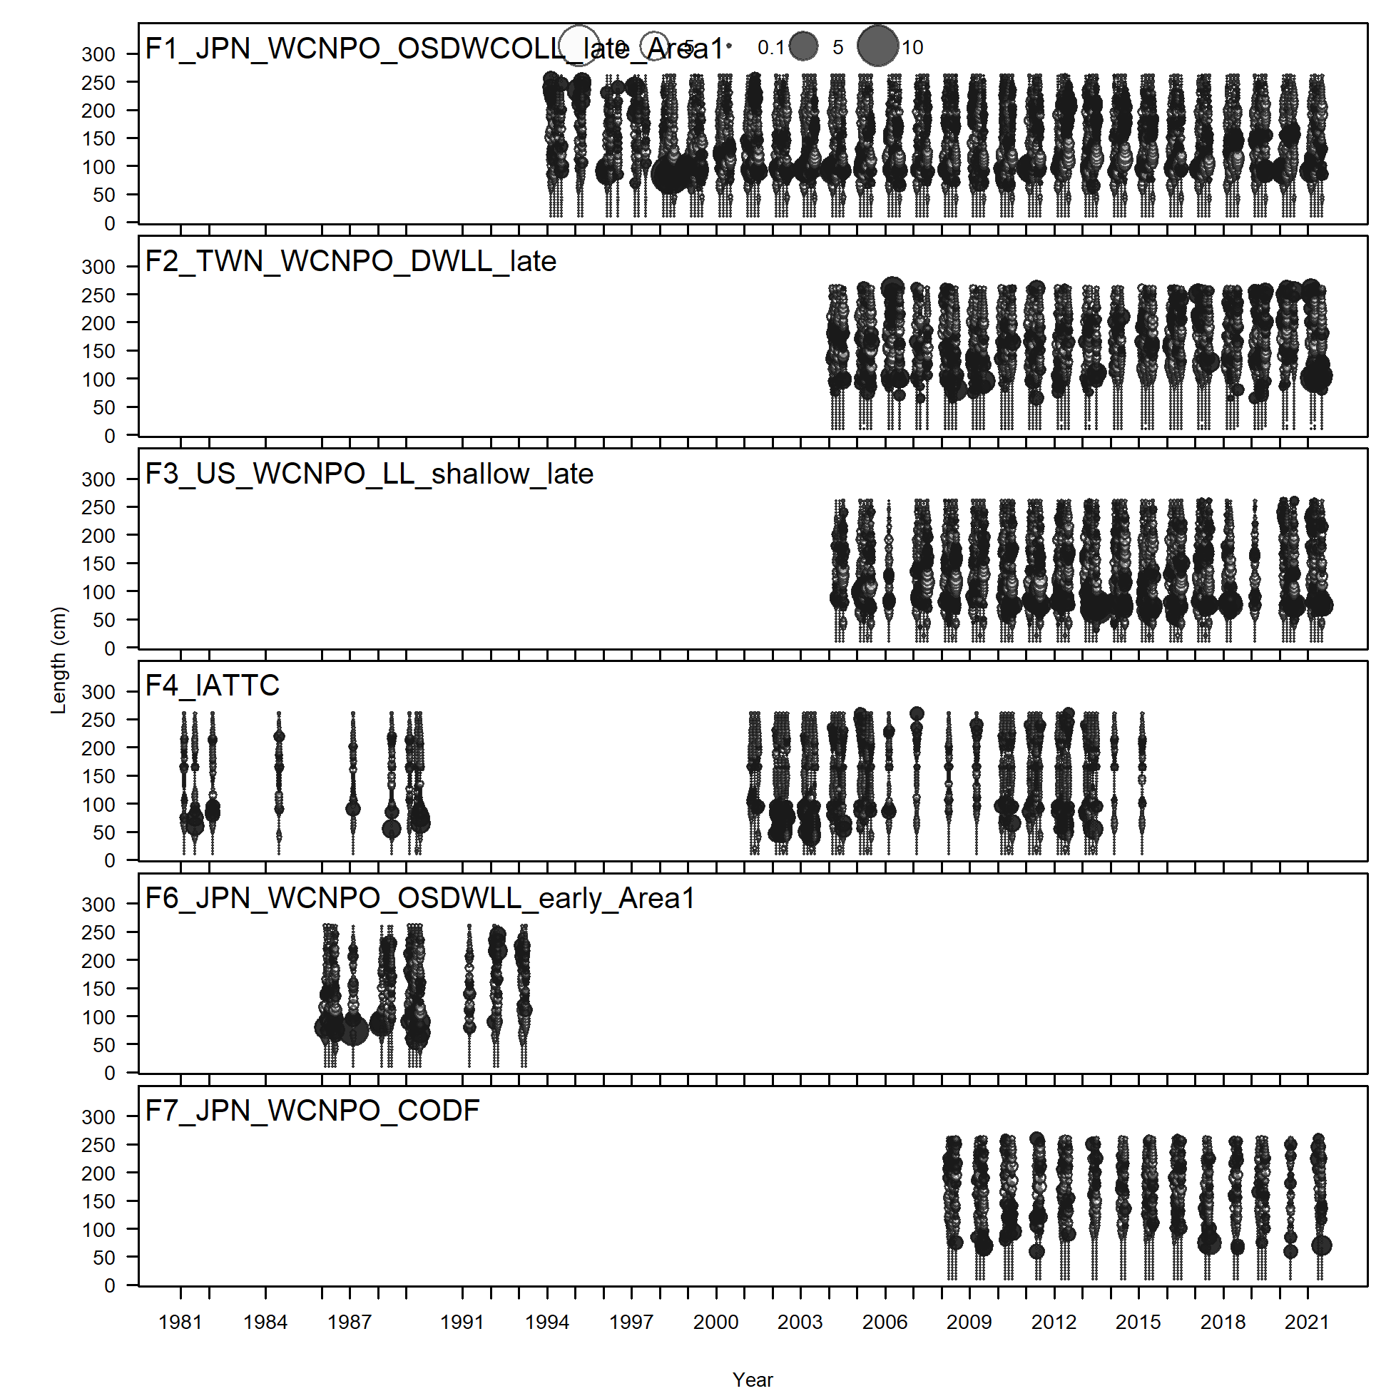
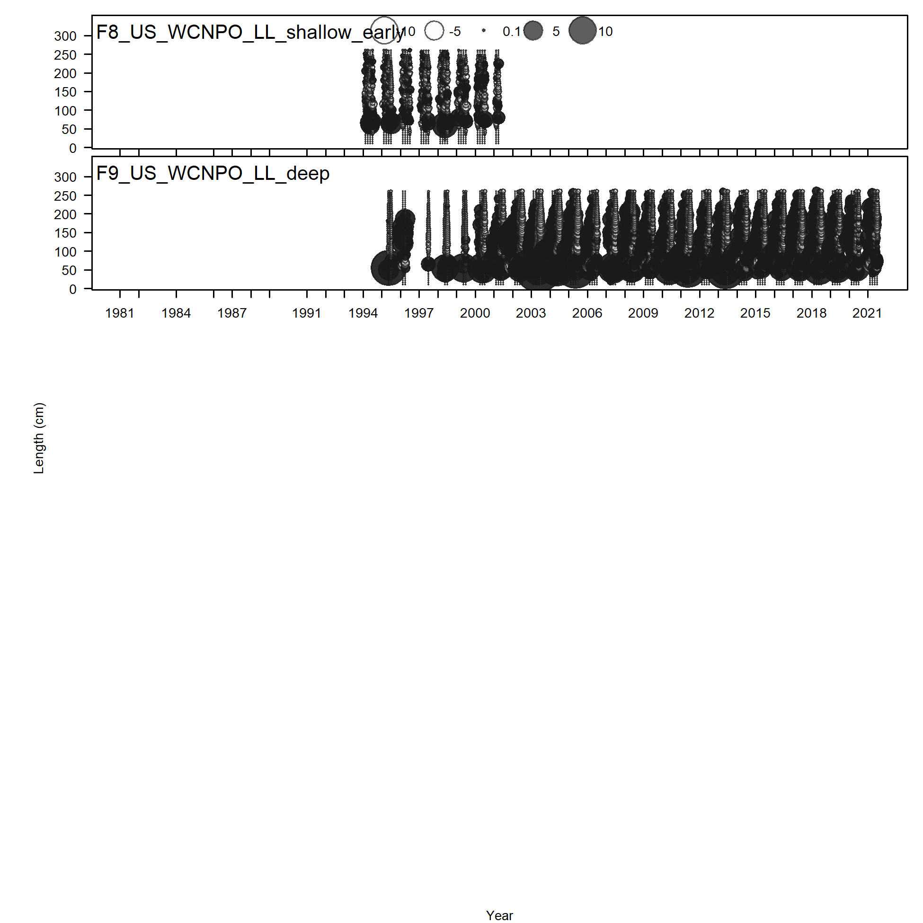

Slide 9
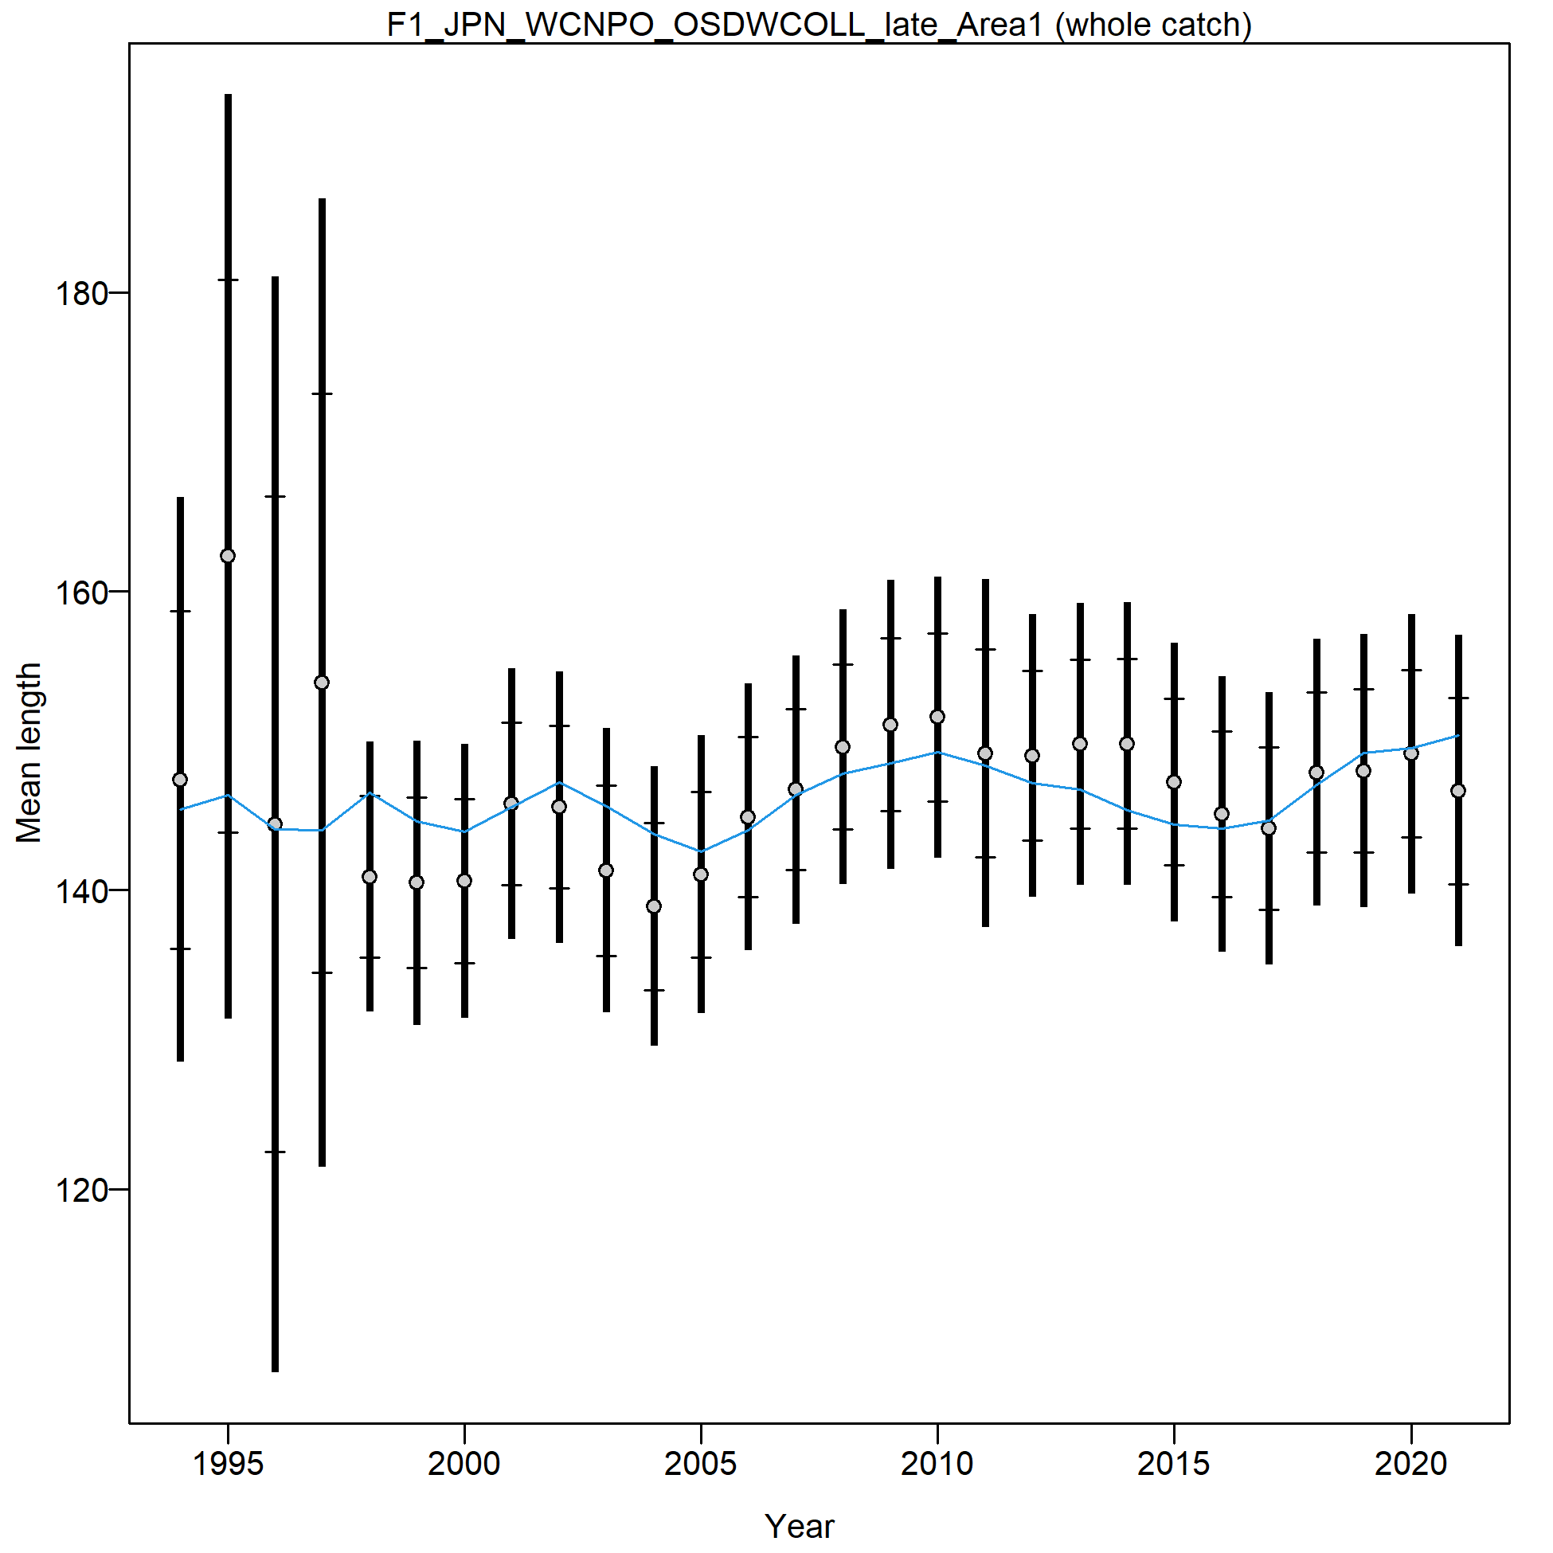
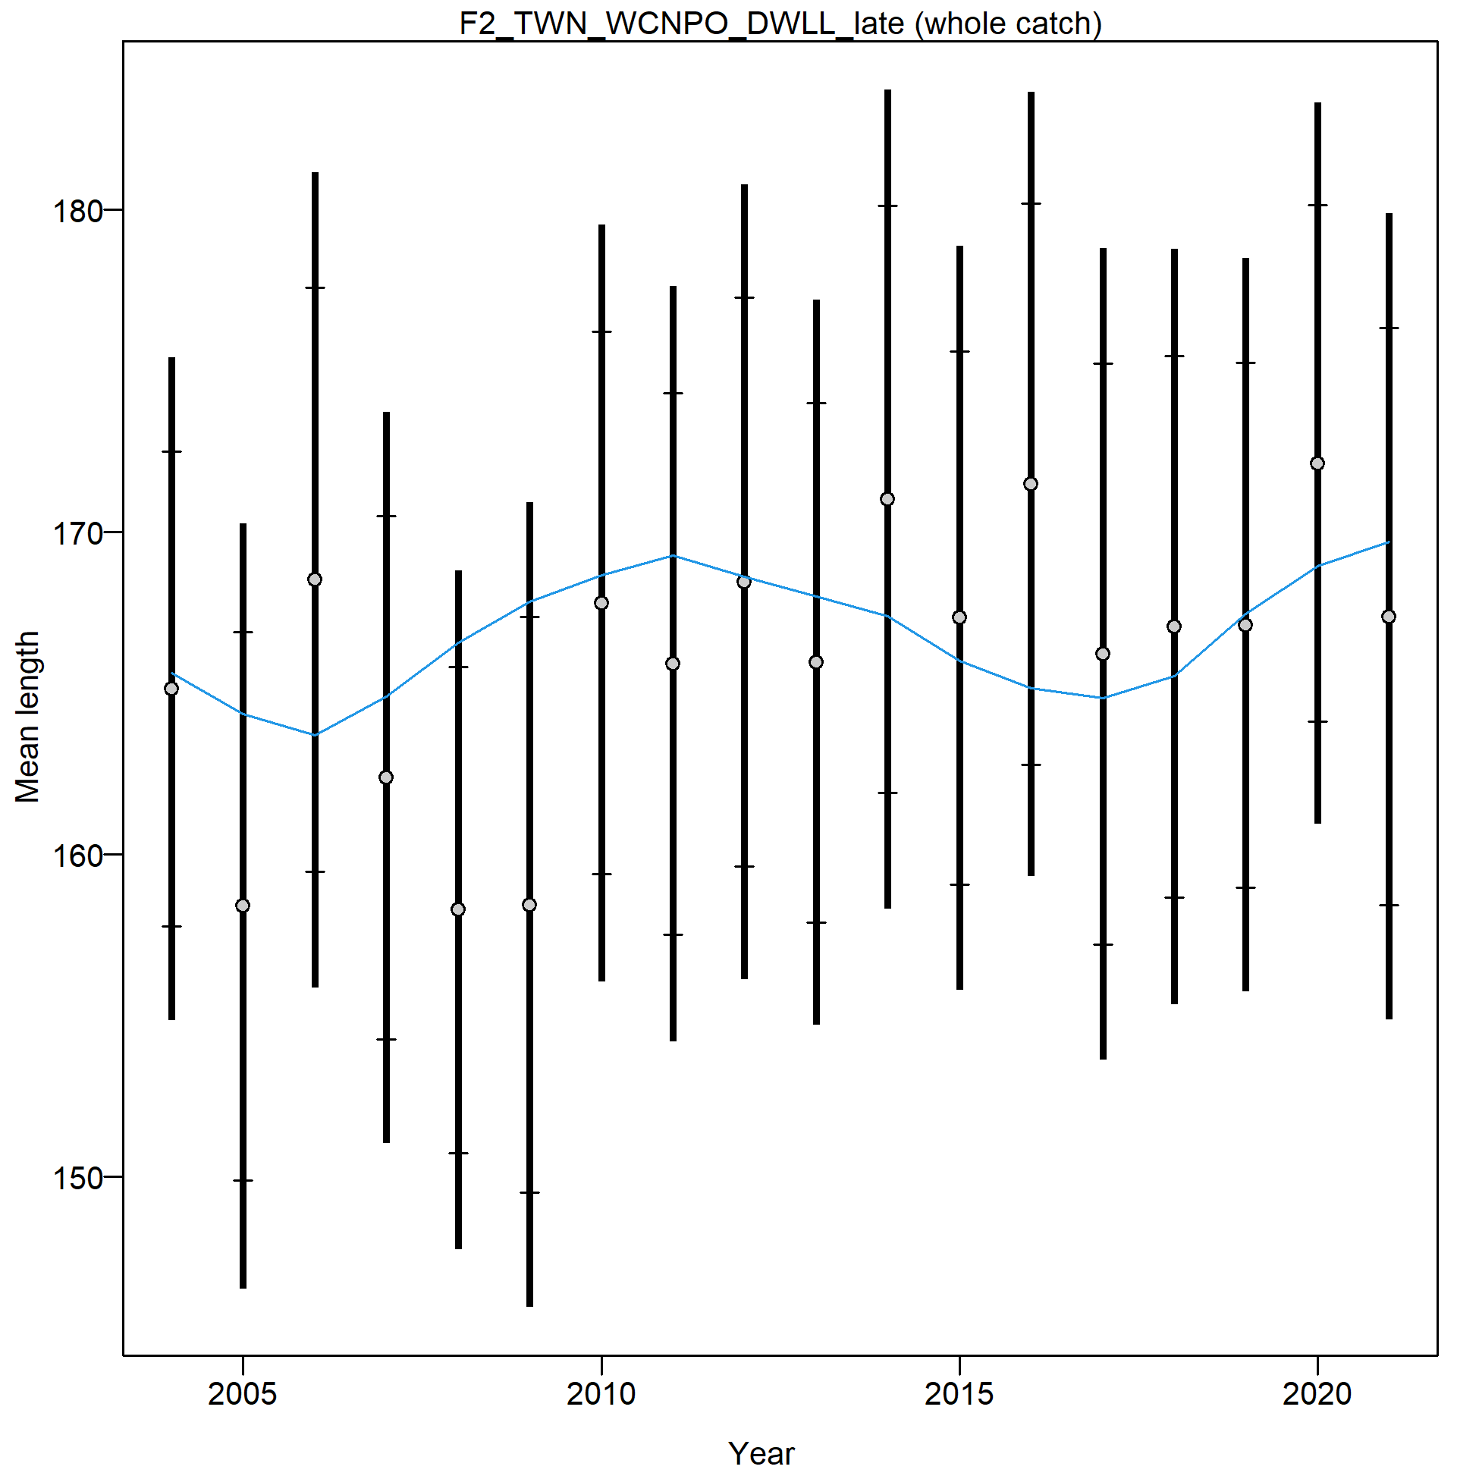
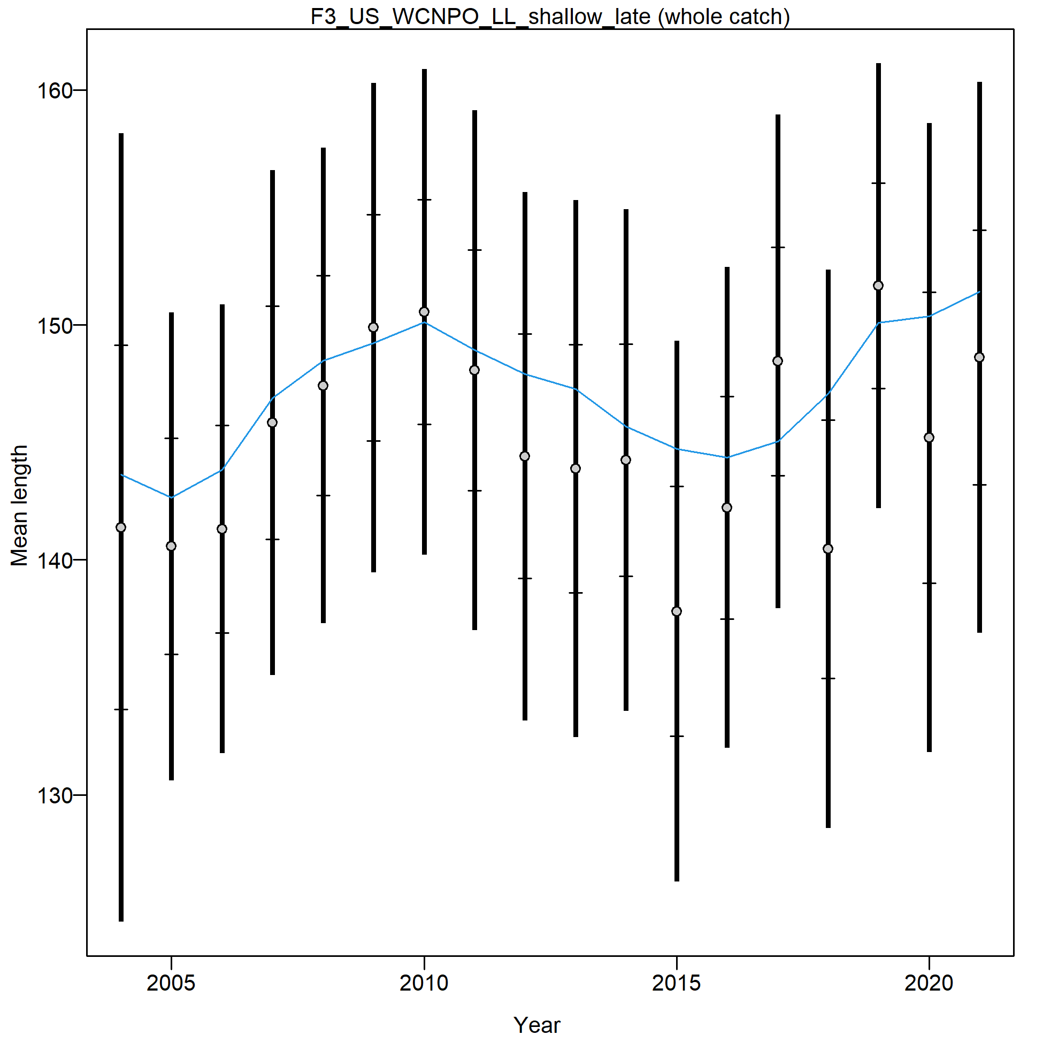
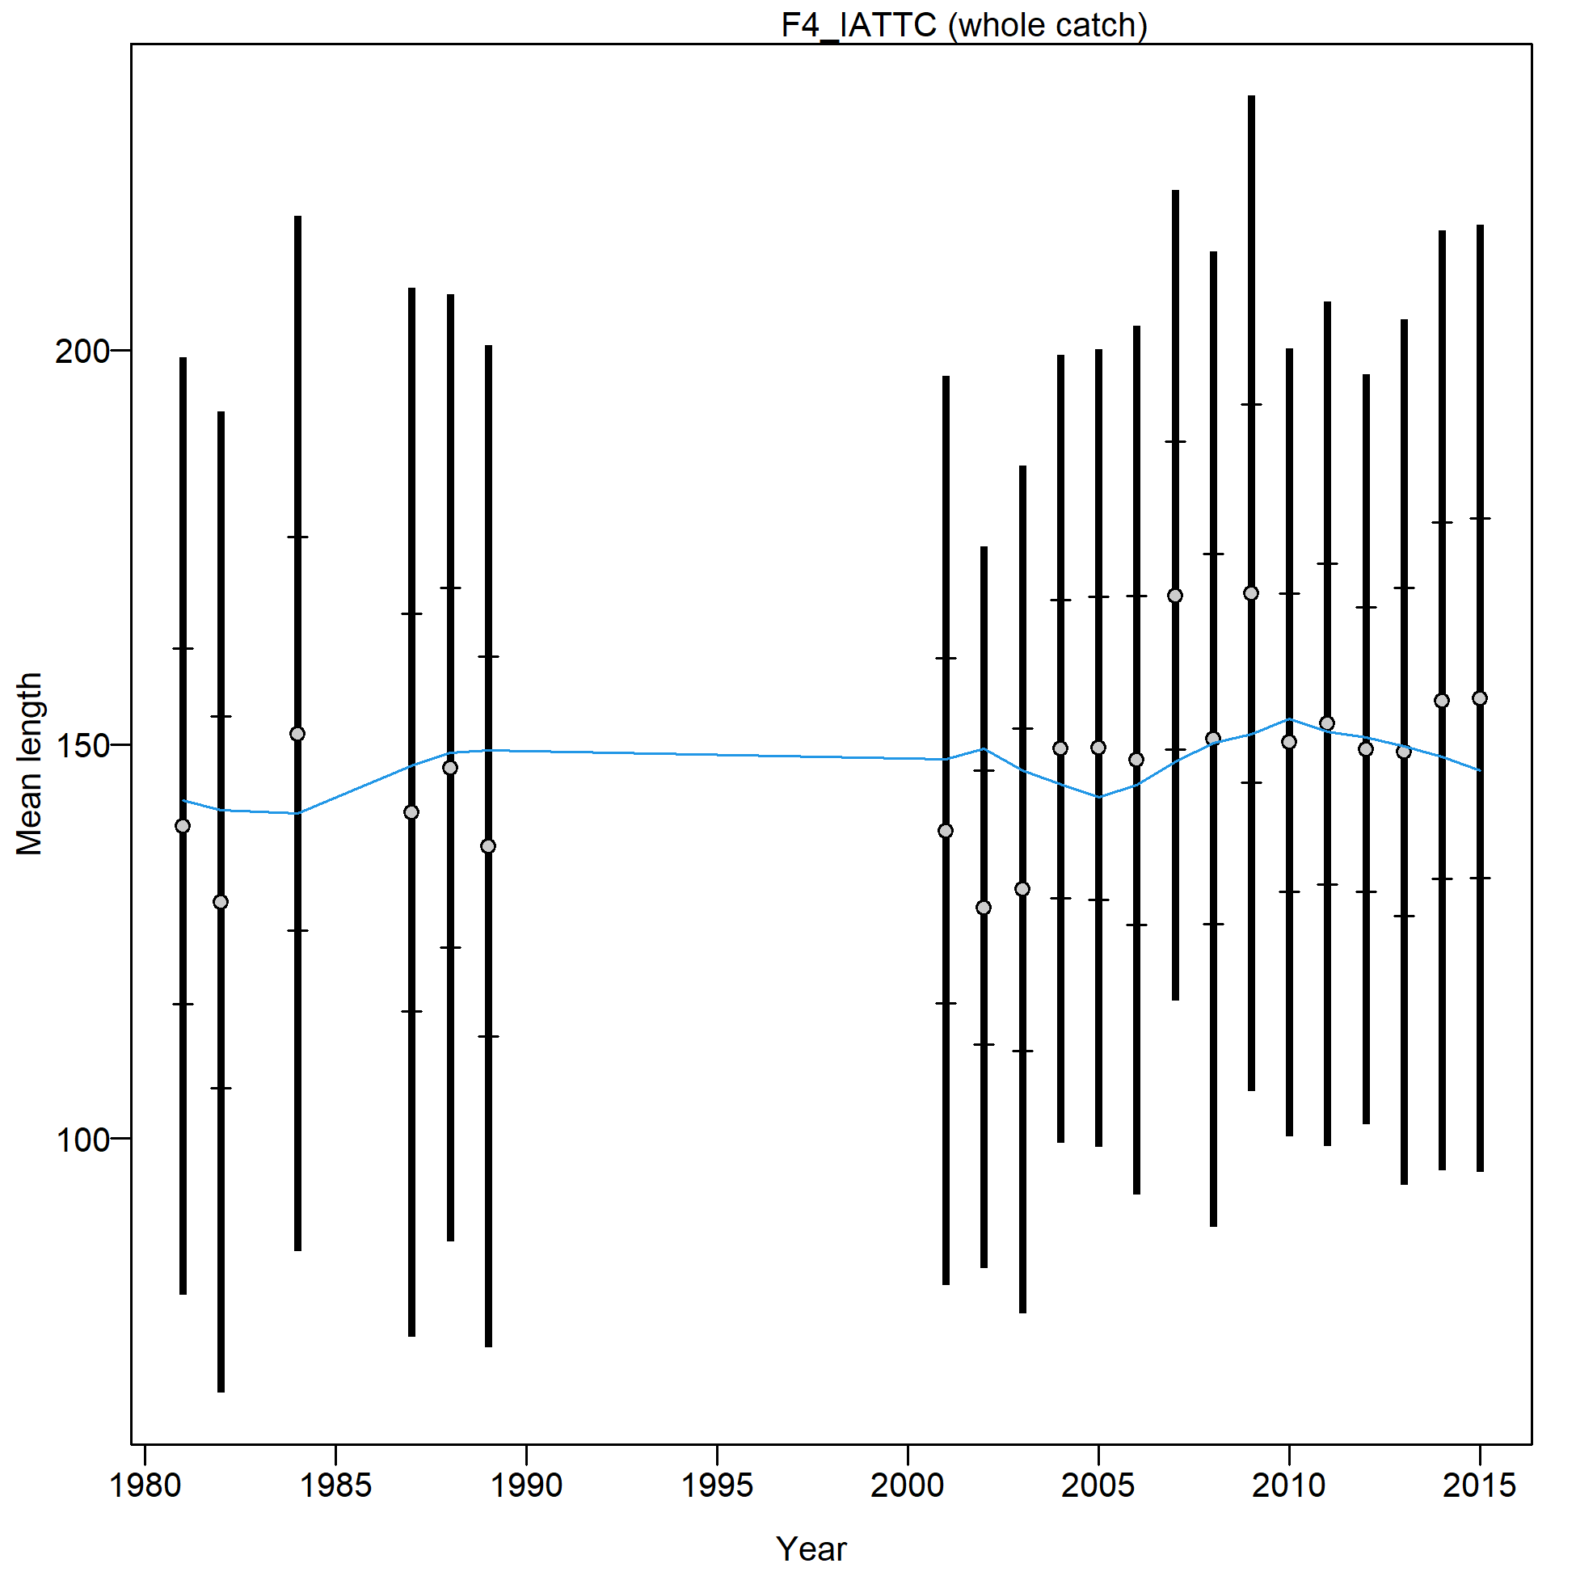
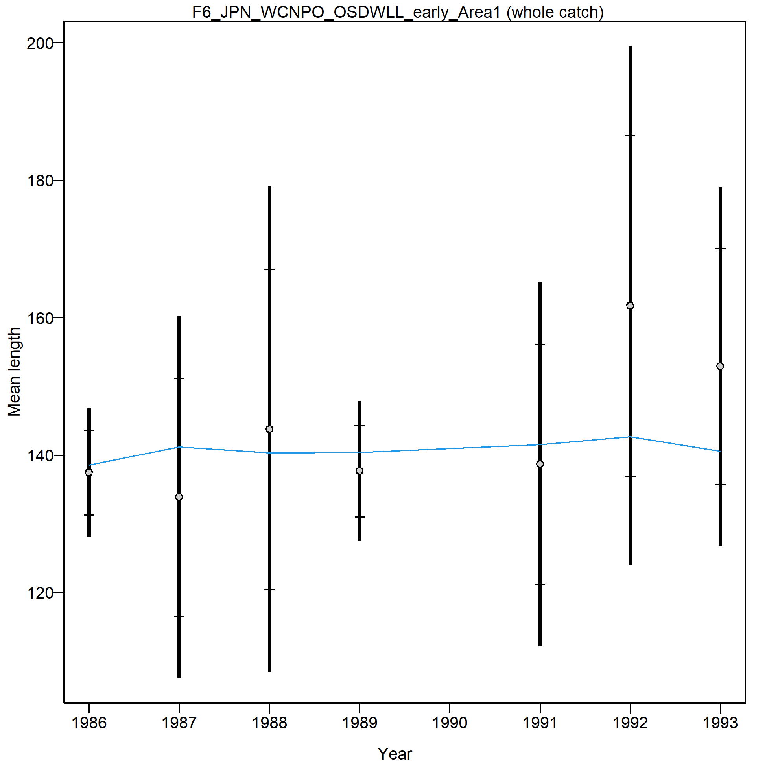
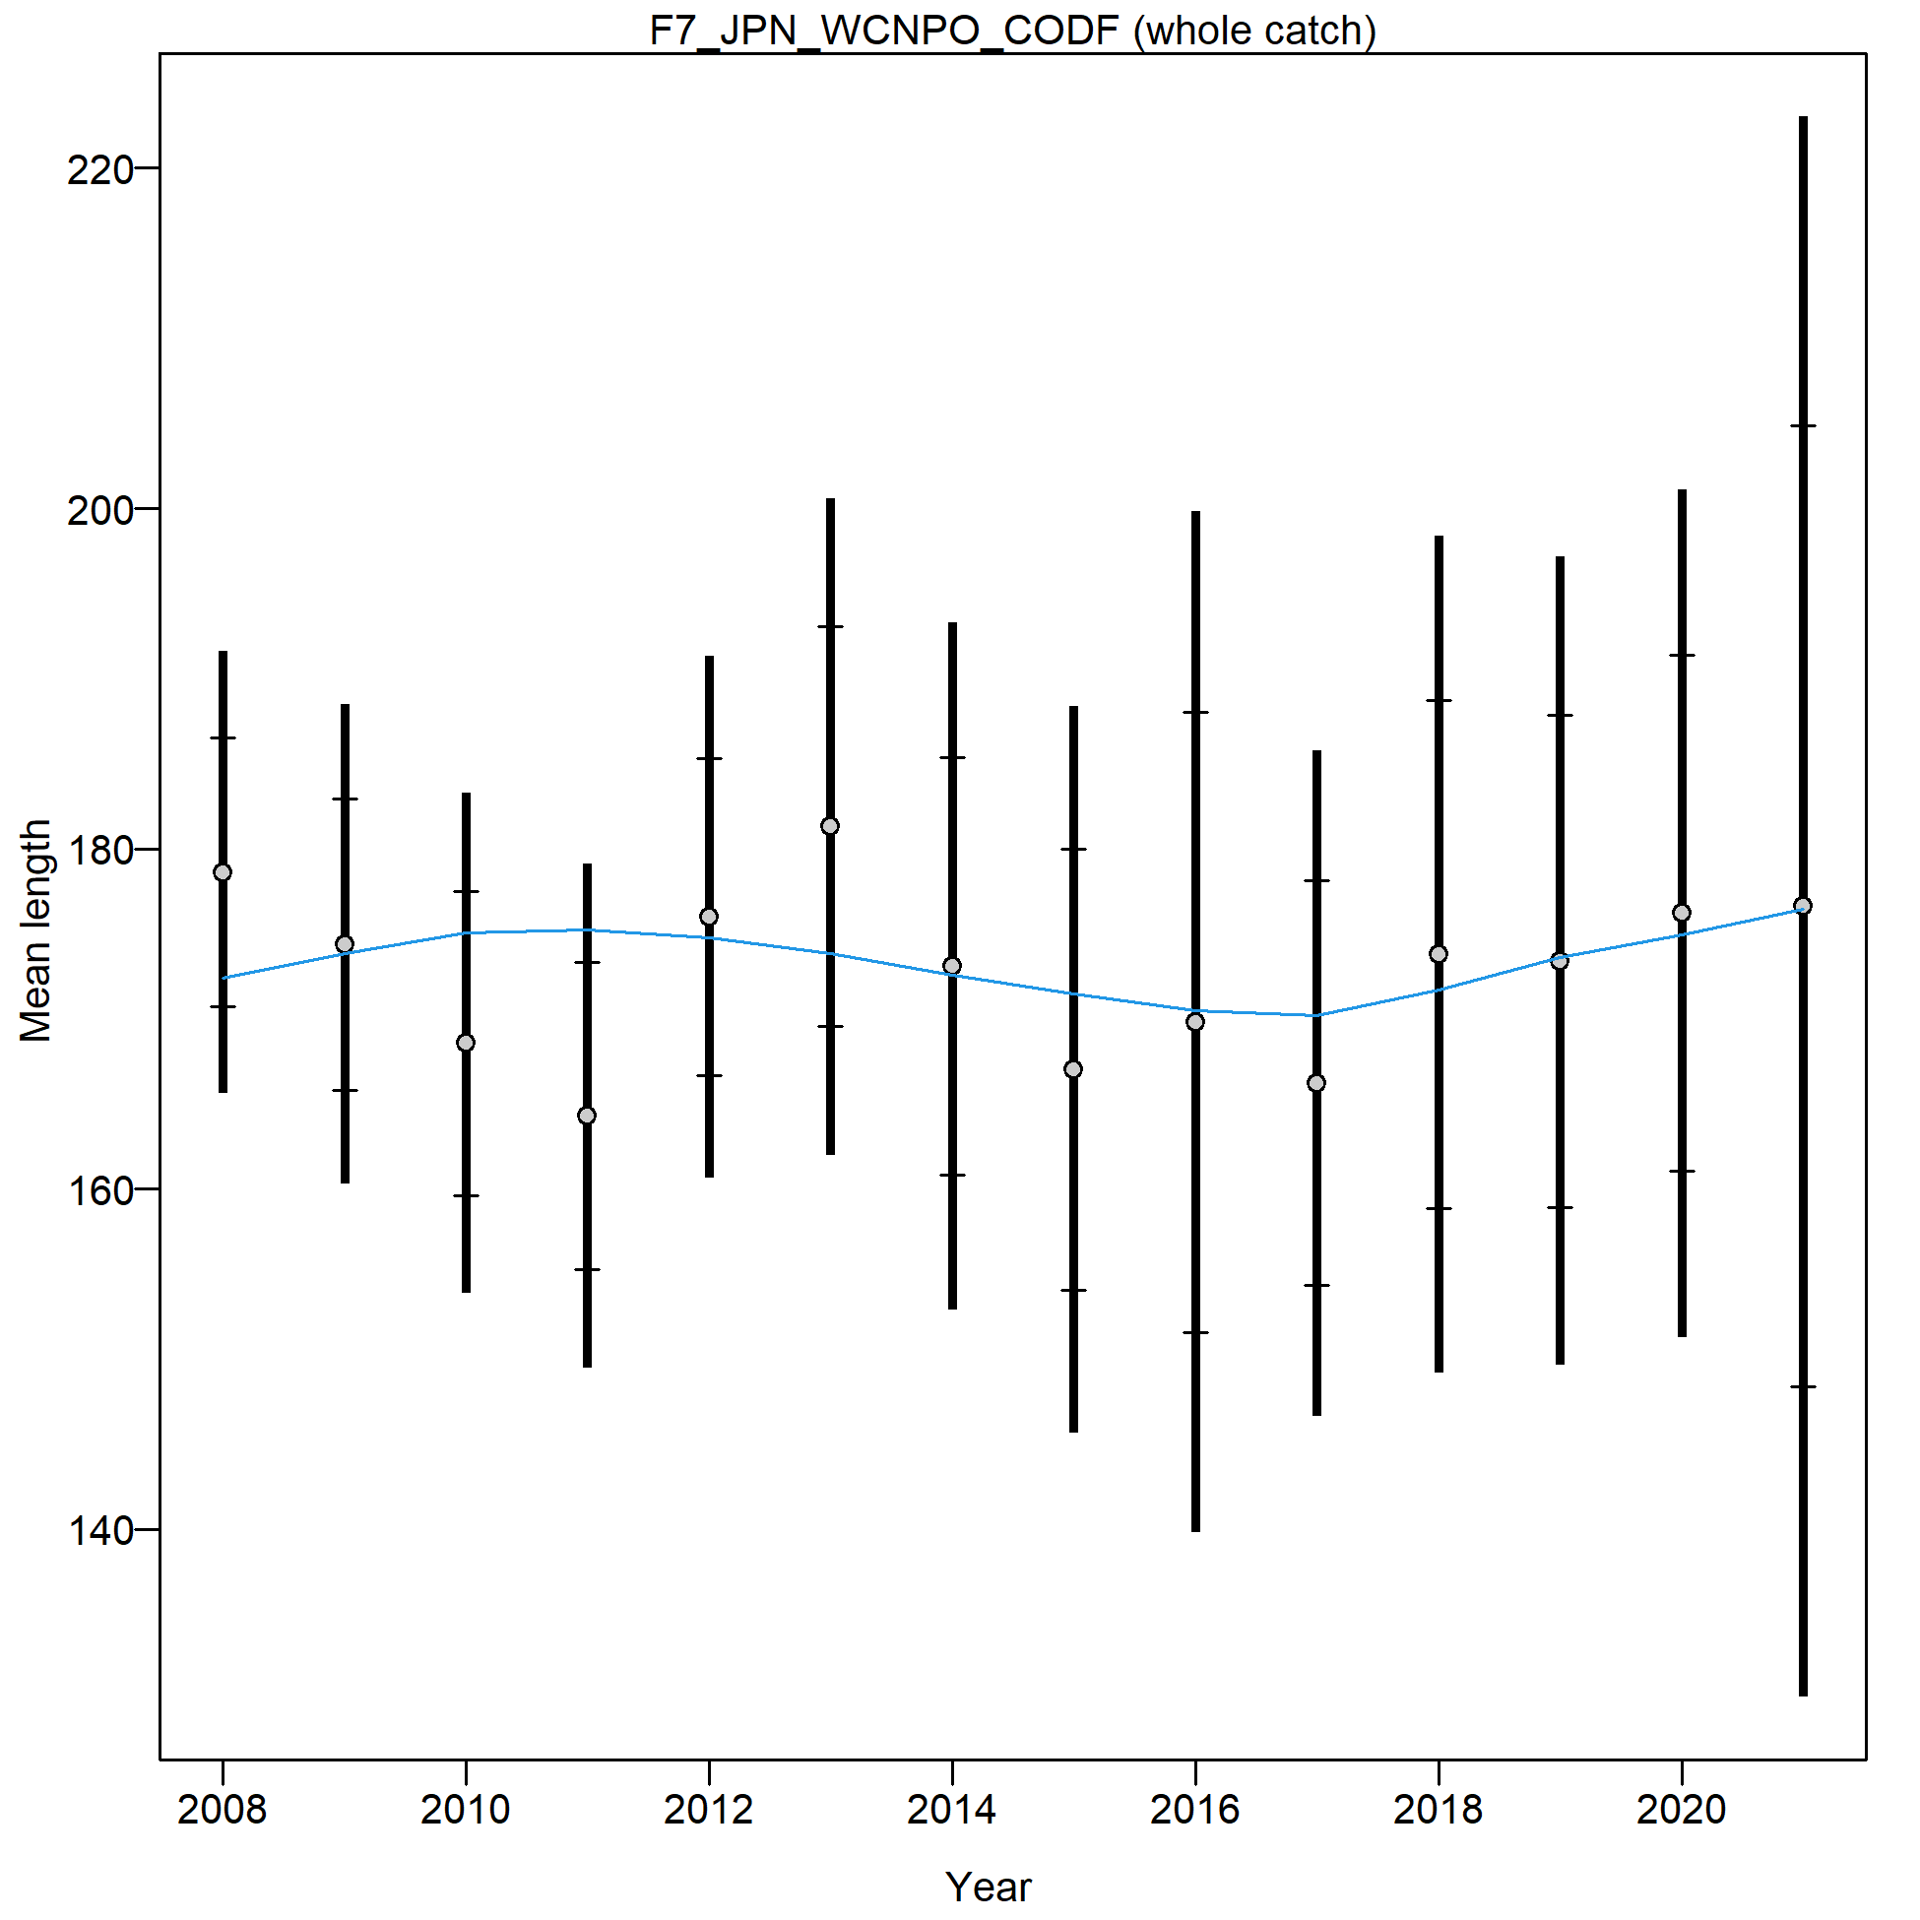
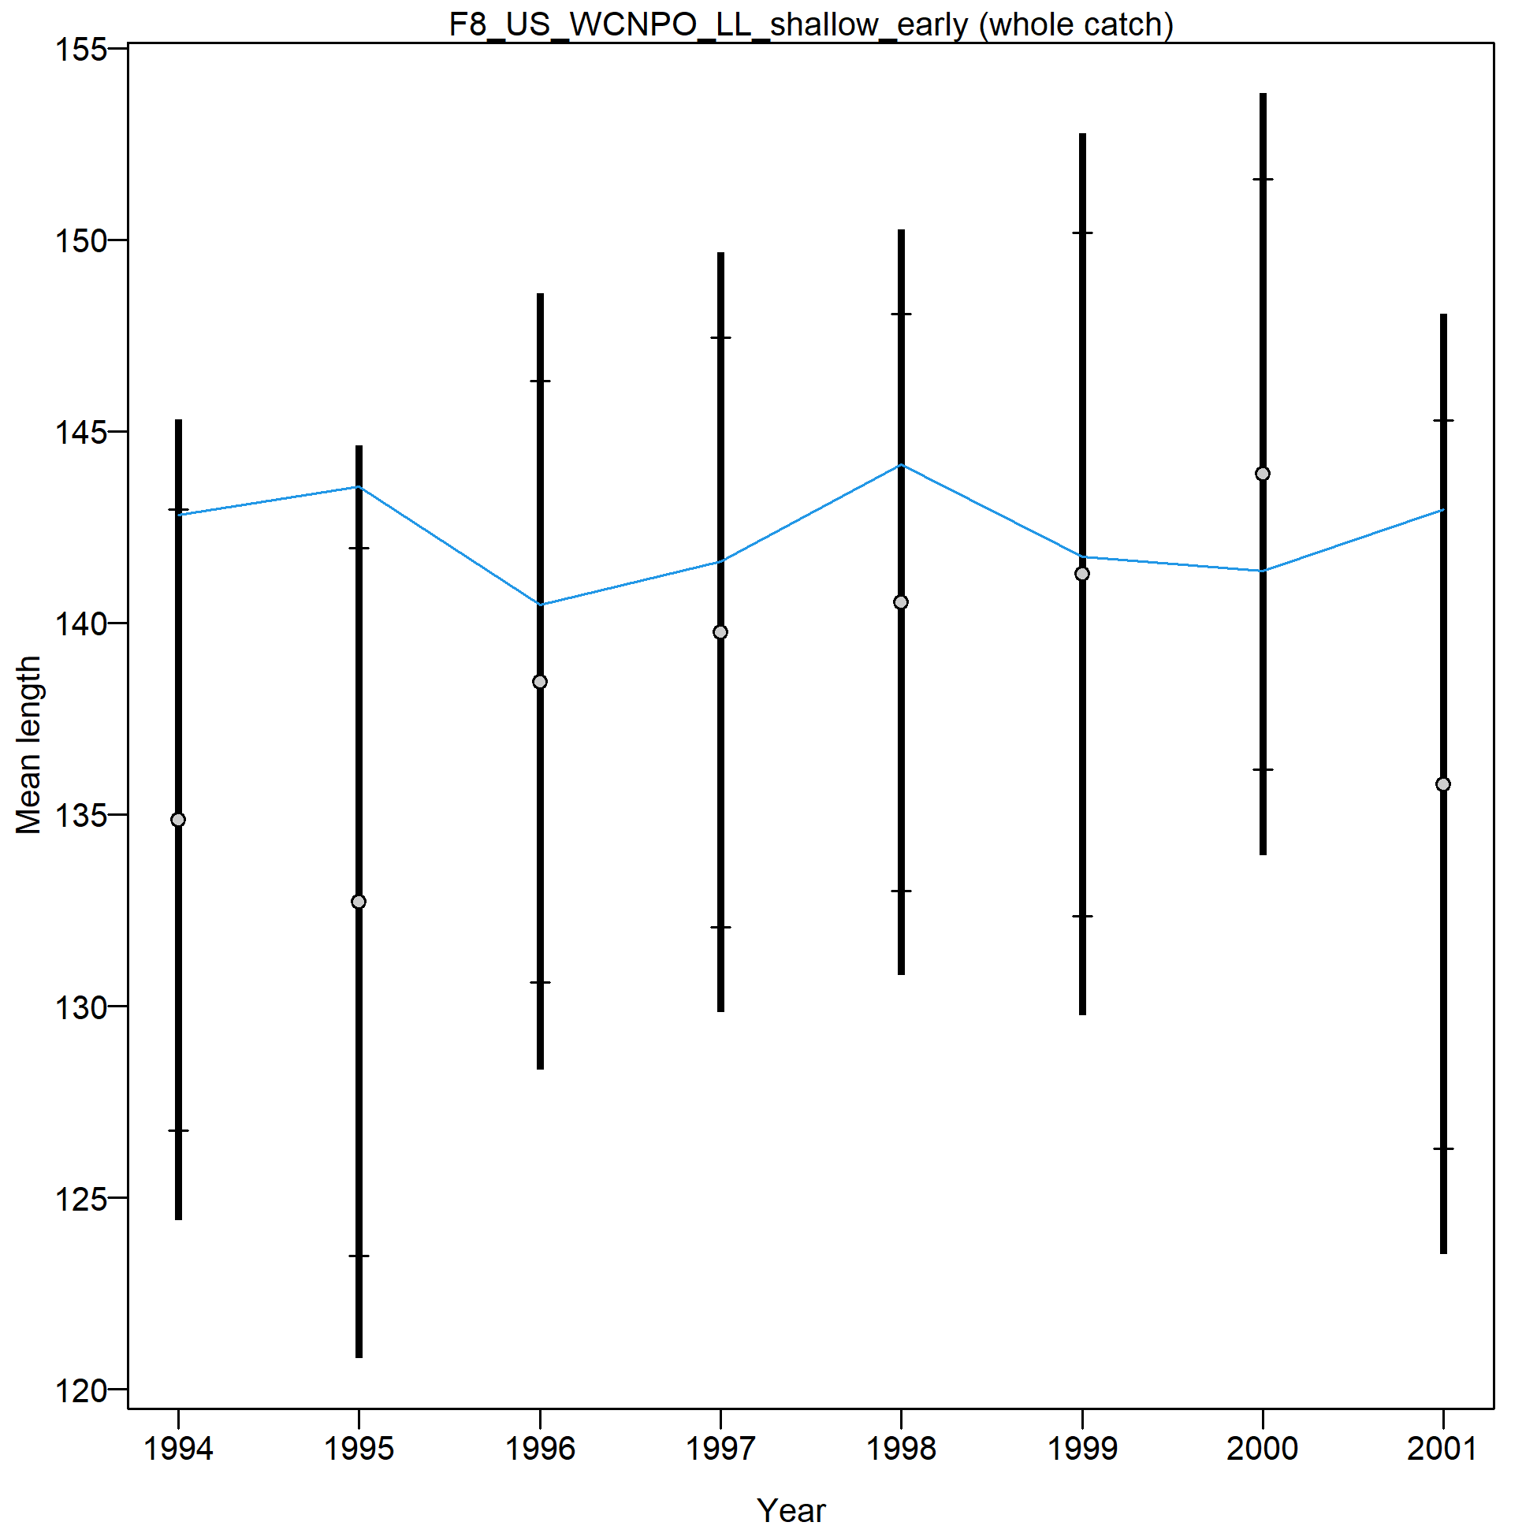
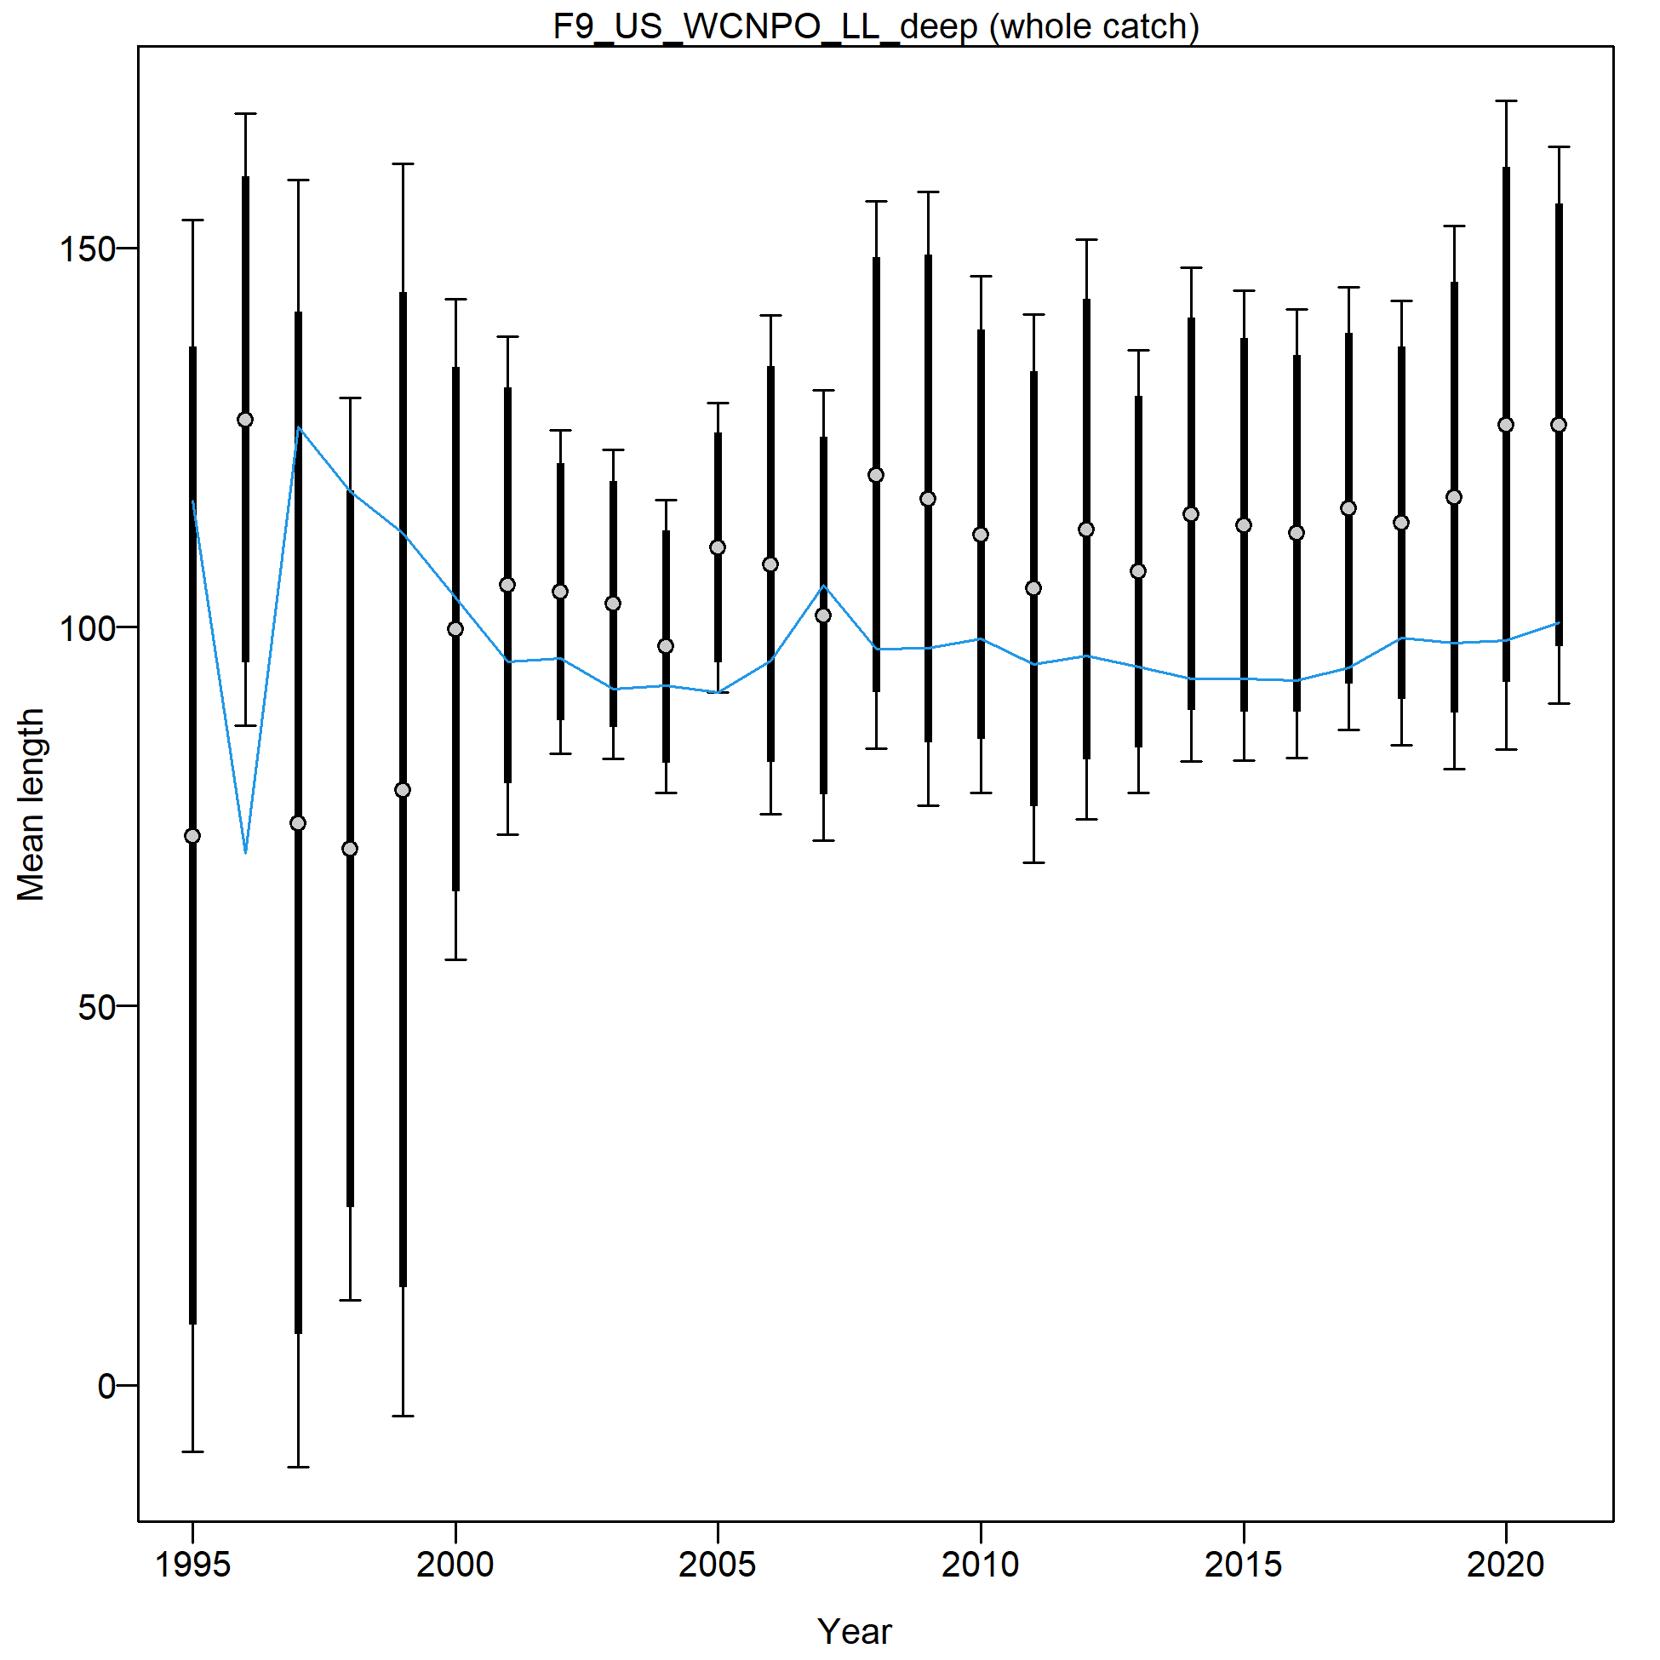

Slide 10
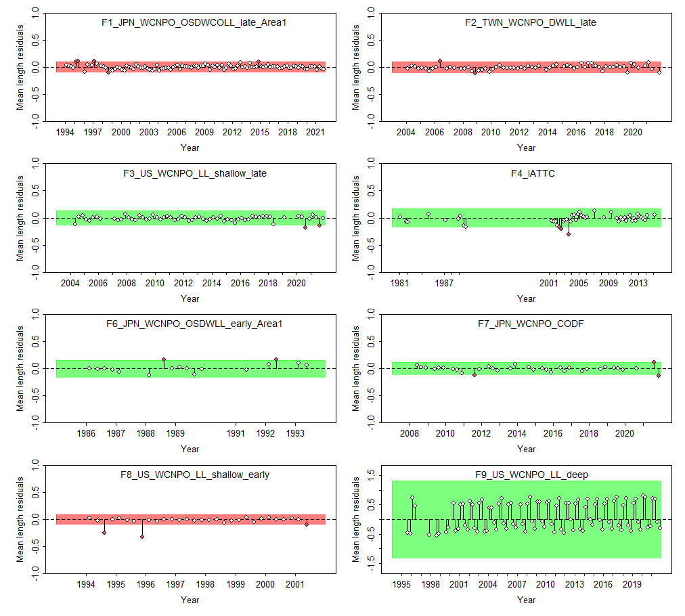

Slide 11
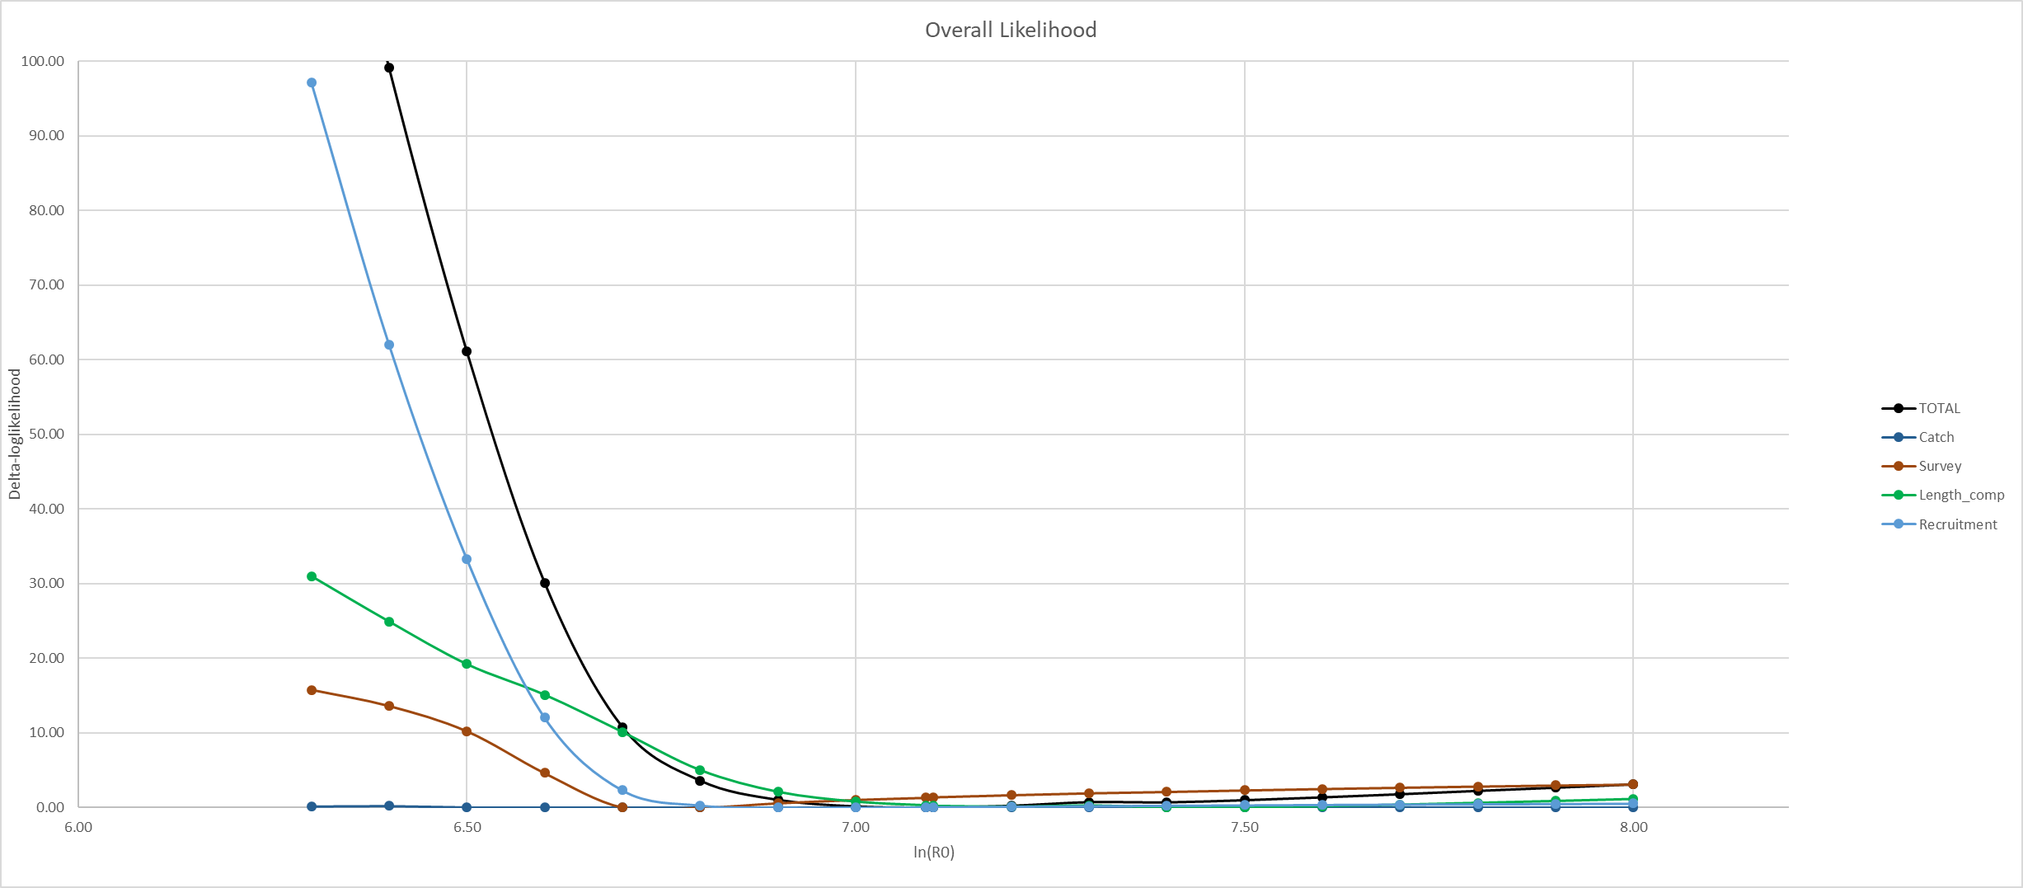
CPUE min: 6.8
Size comp min: 7.4
Rec min: 7.0

Slide 12
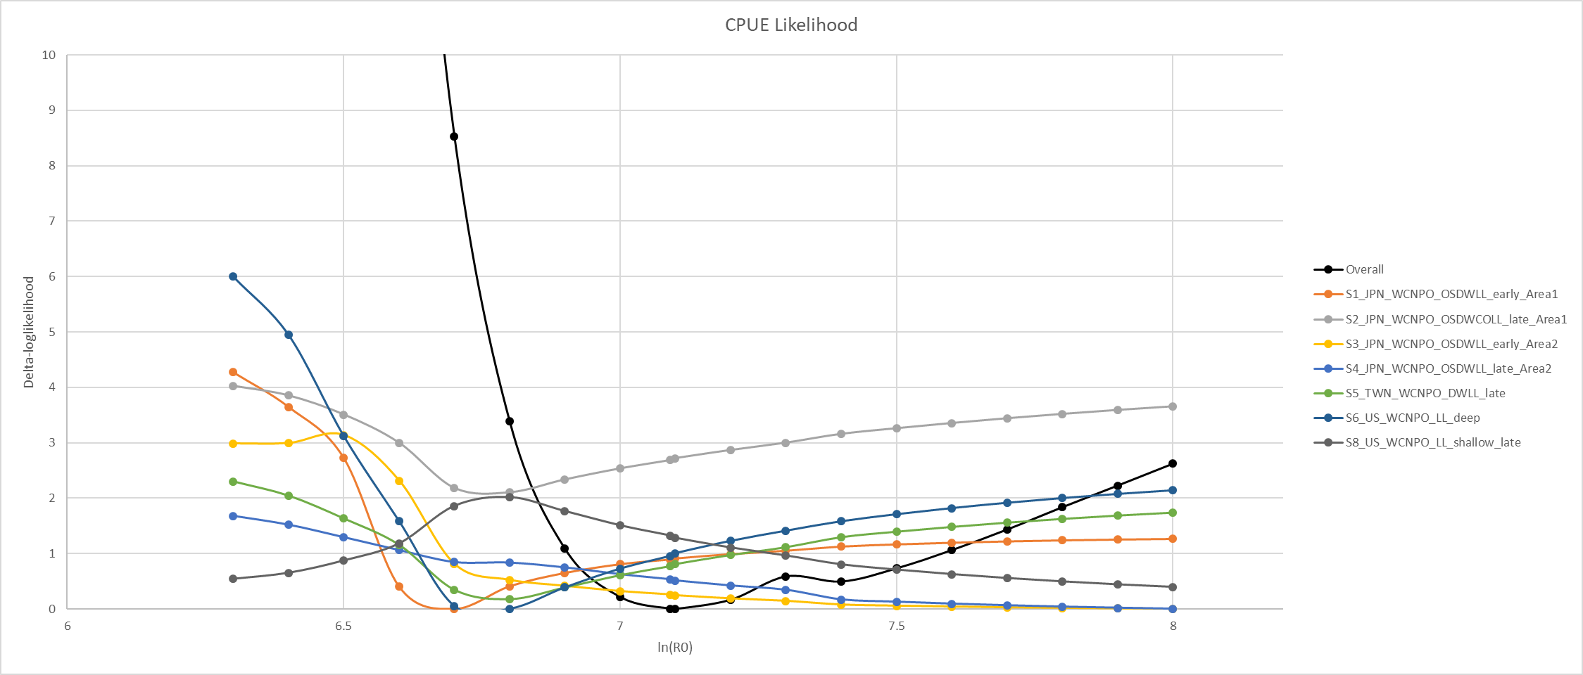

Slide 13
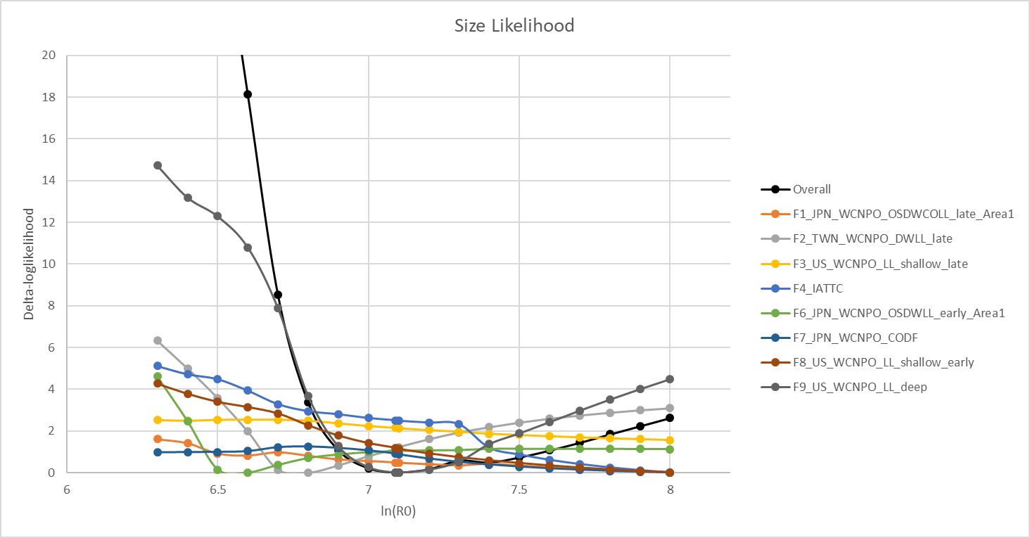
TWN DWLL and US HI LL Deep driving the size comp
Considering dropping/downweighting US deep
JPN LL Area 1 Late, IATTC, JPN LL Area 1 early, and US HI Shallow early all have very large ln(R0) – could be responsible for the model’s tendency to go to unrealistic population sizes
2018 assessment only included F1-F4, dropped all others

Slide 14
Steps thus far
Block on TWN LL size comp
Block on JPN F1 size comp
Tried block on HI LL Deep F9, didn’t improve fit. Dropped
Downweight all size comp lambda to 0.5
Reduces the influence of size comp, allows CPUE to drive biomass trends
Dropped IATTC size comp prior to 2001

